Slide 1
Enterprise Apps & Agents
POWER PLATFORM
Enterprise Code App → Dataverse → AI Builder → Copilot Studio Agent → Governed Automation → Capstone Project

Slide 2
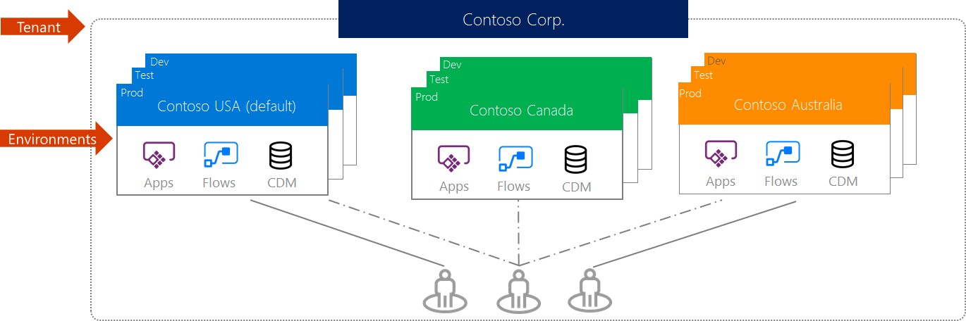
Know your environments
Environments are containers that administrators can use to manage apps, flows, connectors and other assets, along with permission to allow organization users to use the resources.
Notes:
https://support.microsoft.com/en-in/help/4513676/differences-between-flow-approval-actions

Slide 3
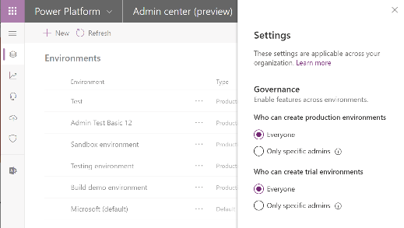
Environment key facts
Environments are tied to a geographic location that is configured at the time the environment is created
Environments can be used to target different audiences and/or for different purposes such as dev, test and production
Every tenant has a Default environment where all licensed Power Apps and Power Automate users can create apps & flows
Non-default environments offer more control around permissions
Non-default environment creation can be restricted to only global and service admins from the Power Platform admin center: https://aka.ms/ppac
Notes:
For data residency concerns, envs are tied to geographic location
Every tenant has a default environment, created automatically.
Additional envs for DevOps, for permission reasons
Full control over who can create those environments
Control who can create and manage environments in the Power Platform Admin center: https://docs.microsoft.com/en-us/power-platform/admin/control-environment-creation

Slide 4
Types of environments
Type | Description
Trial | Expire after 30 days, limit 1 per user
Developer | One per user - community program – single user
Default | Every tenant has one default environment – useful for personal productivity assets
Sandbox | Non-production environment enables some additional options like copy and reset
Production | Non-expiring full environment
Notes:
Developer environment is created whenever a user signs-up for the PowerApps community plan - http://aka.ms/powerappcommunityplan, can’t restrict unless with service ticket
Production environments can be created by any licensed user as long as there is 1GB of remaining storage capacity

Slide 5
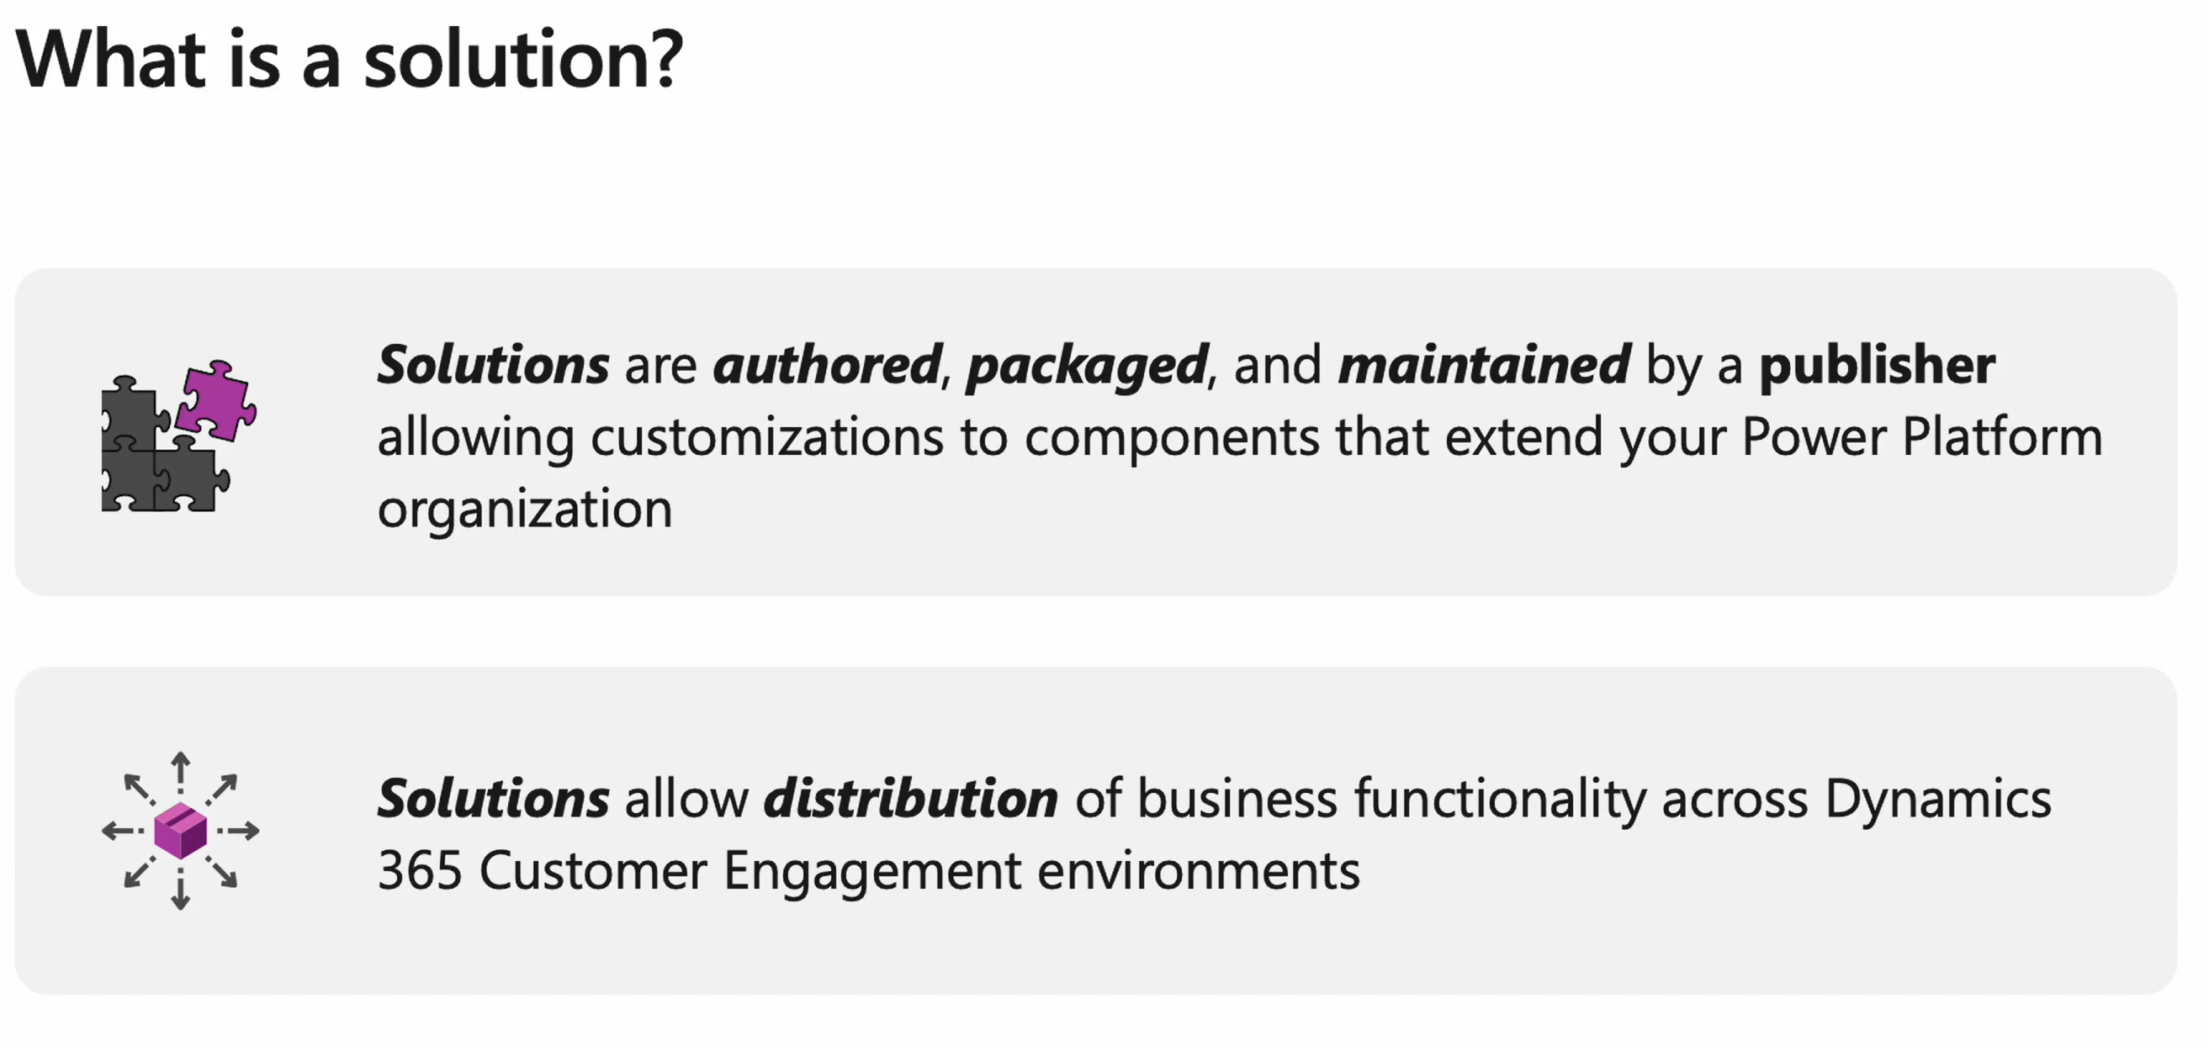
Solution
Notes:
https://learn.microsoft.com/en-us/training/modules/introduction-solutions/introduction

Slide 6
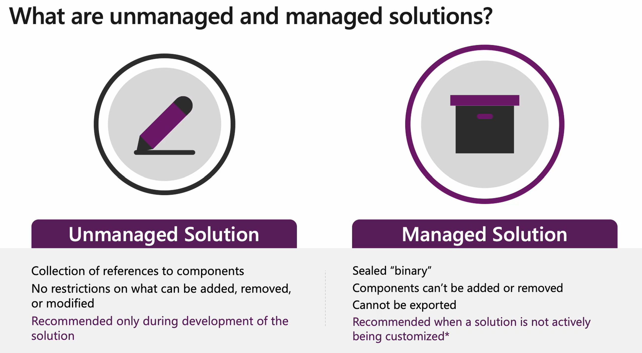
Notes:
https://learn.microsoft.com/en-us/training/modules/introduction-solutions/introduction

Slide 7
Deploy to Power Platform
Promote the same versioned solution through controlled environments.
DEV
TEST / UAT
PRODUCTION
Build and validate
Developer testing, mock data, fast feedback
Verify behavior
Integration tests, business acceptance, permissions
Release safely
Approved change, monitoring, rollback plan
→
→
Promotion checklist
Operational readiness
Import solution • Configure variables • Bind connections • Assign roles
Smoke test • Monitoring • Support owner • Rollback path

Slide 8
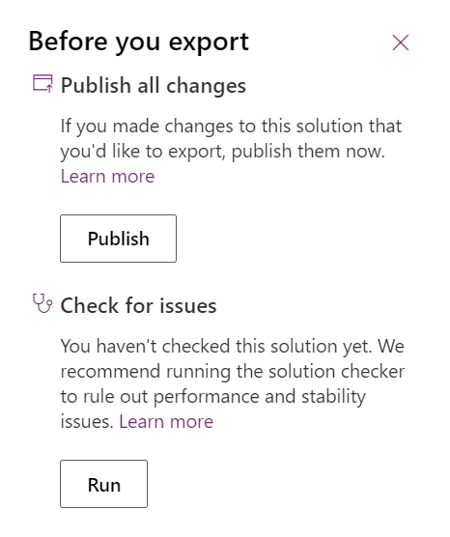
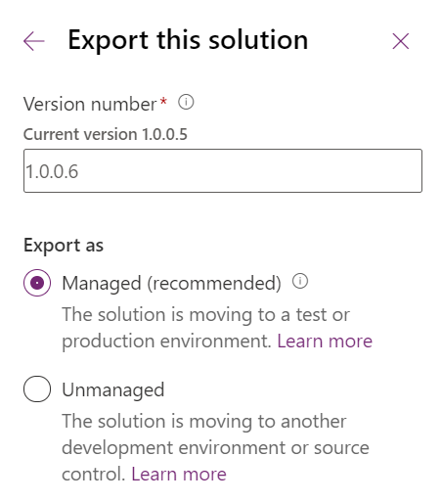
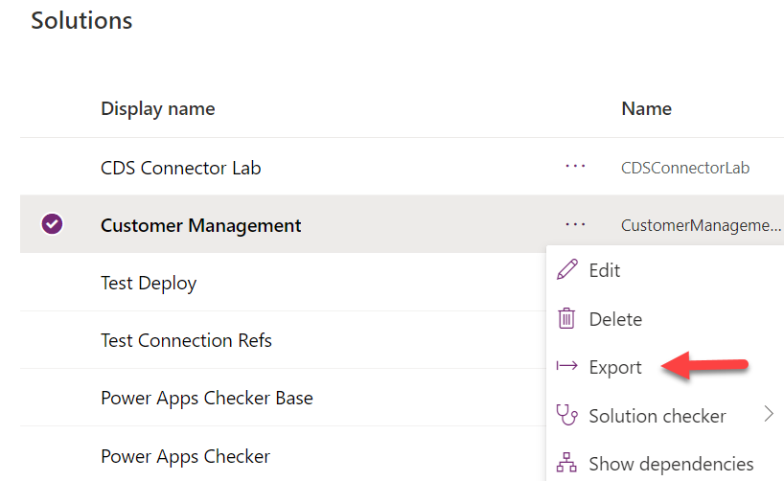
Manual Solution Export
Always export both managed and unmanaged
  Managed solutions are deployed read-only to test/production.
  Unmanaged solutions can be used to restore your dev environment or store in source control.
Publish all and check for issues should be part of your export process
Notes:
Remove the current value for environment variables from your solution if you don't want to use it in the next environment. https://learn.microsoft.com/en-us/power-apps/maker/data-platform/environmentvariables#how-do-i-remove-a-value-from-an-environment-variable

Slide 9
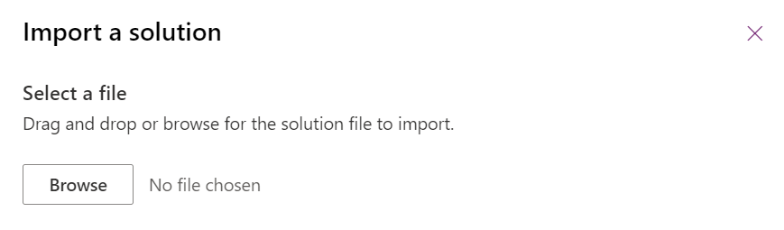
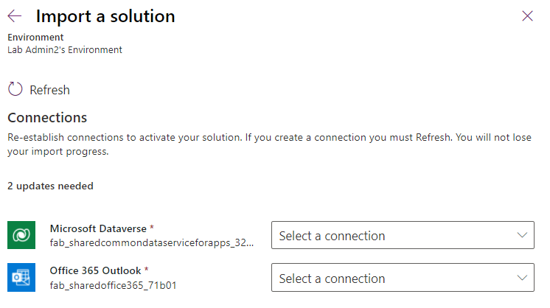
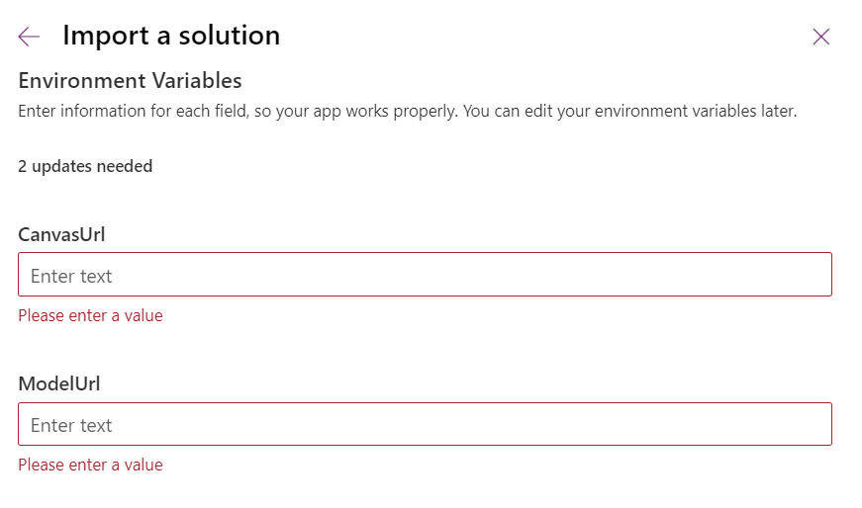
Manual Solution Import
Allows hooking up each connection reference to a valid connection or setting up new connections as required
Allows setting any environment variables
Connections and environment variable values are retained during updates
Notes:
When you do a manual import if there are any connections in use you'll be prompted to establish the connection references
if the solution has any environment variables you will be given a chance to provide values these values will be stored as the current value for that definition

Slide 10
ALM & DevOps
Automate repeatable releases with source control, pipelines, and environment strategy.
01 Source control
02 CI / CD pipeline
03 Environments
Git repository
• Feature branches
• Pull requests
• Code review
• Version tags
Automated build
• Lint & tests
• Package solution
• Publish artifacts
• Approval gates
Development
→ Test / UAT
→ Production
Separate access and configuration
Use Microsoft Power Platform Build Tools or the supported Power Platform CLI tasks in your Azure DevOps/GitHub workflow.

Slide 11
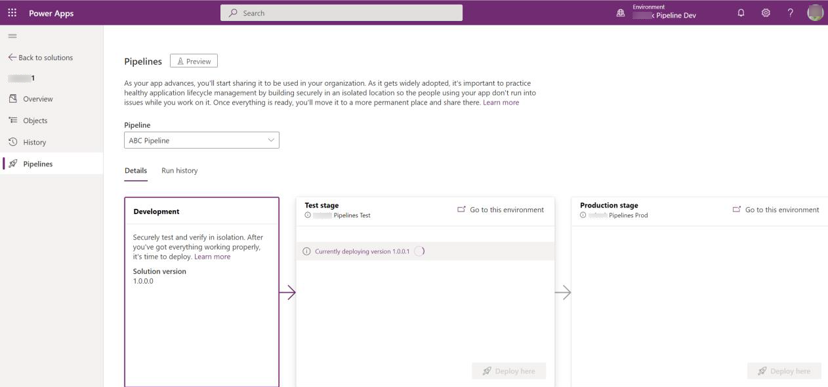
Pipelines in Power Platform
Admins configure automated deployment pipelines
Makers have a repeatable process for deploying their solutions
Developers can (optionally) extend pipelines and run them using the Power Platform command line interface (CLI)
Notes:
https://learn.microsoft.com/en-us/power-platform/alm/pipelines

Slide 12
Automating ALM – Power Platform Build Tools
Initiate
Build
Release
Getting started, faster
Build and Test Automation
Automated, Predictive, Repeatable
Create
Repo
Export
Unmanaged
Unpack
Solution
Check in
to source
Run Unit
Test
Run
Power Apps
Checker
Export
Solution
Unpack to
Repo
Run Unit
Test
Pack
Solution
Run
Solution
Checker
Run
Integration
Test
Import as
unmanaged
Increment
Version
Export
Managed
Provision
Environment
Deploy
Dependencies
Pack Source
Code from
Repo
Import
Solution
Initial Build Pipeline instantiates pristine Development Environment daily, exports solutions and unpack to Source Control
Build Pipeline Automates manual steps.
No more upload to Solution checker and manually export solution, unpack and
push to repo
Automated Release Pipeline removes manual steps. Weekly, daily or hourly releases becomes the new standard
Powered by Azure DevOps and Git
Notes:
Power Platform Pipeline

Slide 13
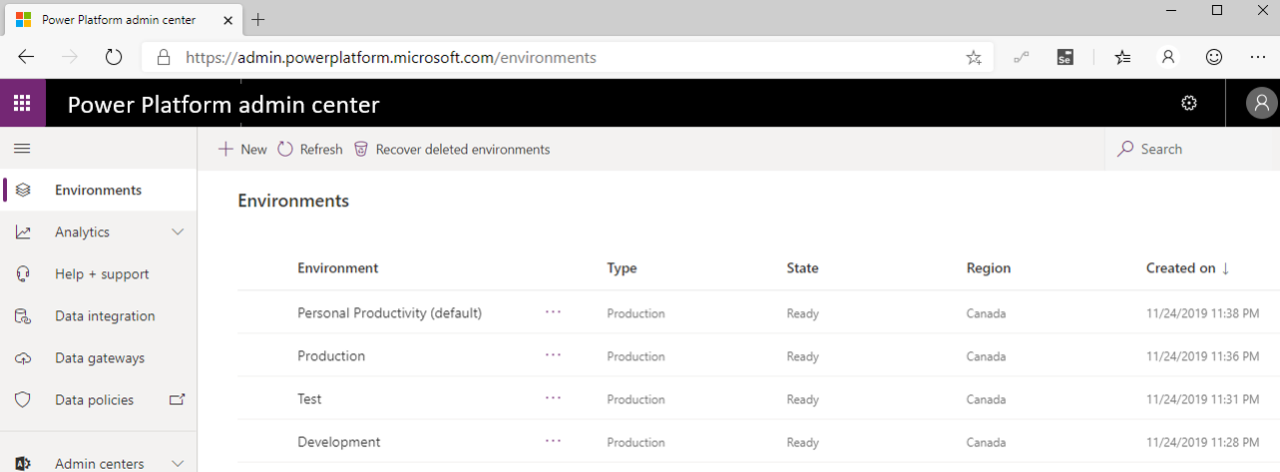
Identify Microsoft Power Platform Environments
Notes:
Environments are an important consideration when you are trying to help secure and govern Power Apps and Power Automate usage.
Environments act as a security container for apps and flows to run within.
Every flow must be assigned to an environment.
Every licensed user belongs to the default environment.
Additional environments can be provisioned where opt-in access is possible. A strategy that some organizations adopt includes renaming the default environment to be called Personal Productivity, which implies permission to build flows that improve their own productivity.
Organizations can subsequently create additional environments for development, testing, and production purposes. Using this strategy might also align flow creation with existing IT change management requirements.
By default, anyone can create environments, but administrators can also control who can create and manage environments in Microsoft Power Platform Admin center and limit it to a set of administrators.

Slide 14
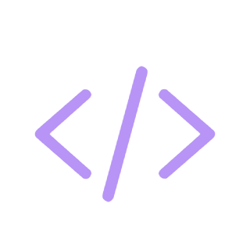
Demo
POWER PLATFORM
H1. Banking: test a payments module and add diagnostics
H2. Finance: package a managed solution with environment variables
H3. Supply Chain: configure connection references and deploy to test
Notes:
Welcome. This deck walks through what you need before building your first Power Apps Code App, then the six commands that take you from a starter template to a deployed app.

Slide 15
Closing slide
Thank you

